Slide 1
AI Spots What Eyes Miss
Brain‑Tumour MRI • ICS504 Deep Learning
Abdulrahman Kamili • Malik Ibrahim • Hassan Algizani

Slide 3
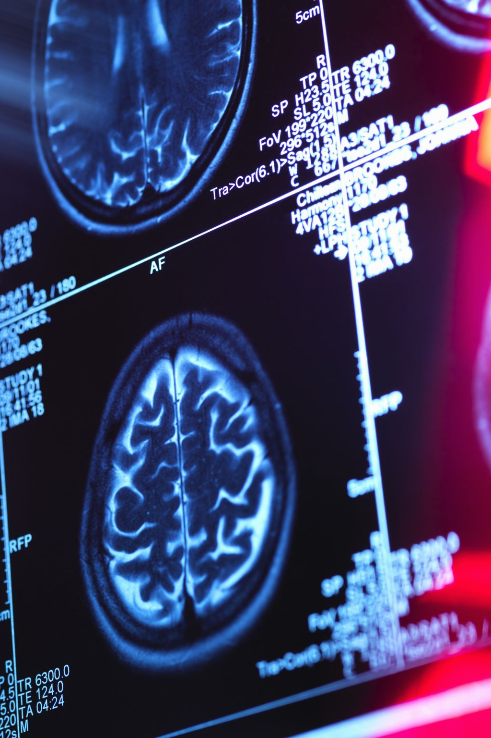
The Urgency of Brain Tumors
300k new cases/year; survival ↓ 30% when diagnosis late
MRI yields 80–100 slices; manual read ≈ 7 min/patient
Fatigue raises miss‑rate to 15 % end‑shift
Automated triage flags critical scans in seconds

Slide 4
Our Journey
Phase 1
Original DeiT baseline
Phase 2
Transformer tweak
Phase 3
CNN ensemble breakthrough

Slide 5

Phase 1 – DeiT Baseline. S. Mahanty et al., 2024
Model:
Performance:
Cost profile:
Limitations:
Take-away: Strong transformer baseline, but heavy and less interpretable—left room for a lighter, clearer, and even more accurate approach.
96 % slice-level accuracy (Macro-F1 ≈ 0.96) on the public test partition—state-of-the-art at the time.
86 M parameters → ≈ 160 ms inference per slice on a Tesla P100; training required mixed-precision and gradient-checkpointing to fit into 16 GB.
Lower recall for minority class pituitary (91 %) and blurry Grad-CAM focus; model confidence over-calibrated (ECE 0.06).
Data-Efficient Image Transformer-Base (12 layers, 768-D, distilled token) fine-tuned on Nickparvar’s 5 712 training slices.

Slide 6
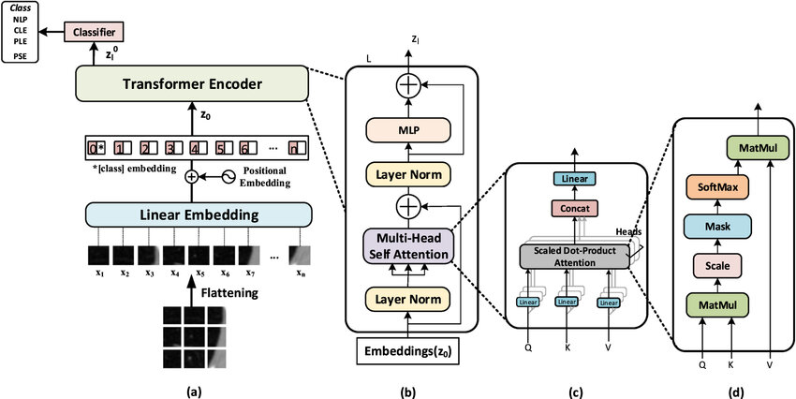

Vision Transformers (ViT)
Breaks the image into patches (e.g., 16×16), flattens them.
Each patch is linearly embedded and positionally encoded.
Adds a [class] token to the sequence for classification.
Uses Transformer Encoder blocks (self-attention + MLP).
Final classification is based on [class] token output.
Reference: An Image is Worth 16x16 Words: Transformers for Image Recognition at Scale
Google Research / Brain Team (Dosovitskiy et al., 2020)

Slide 7
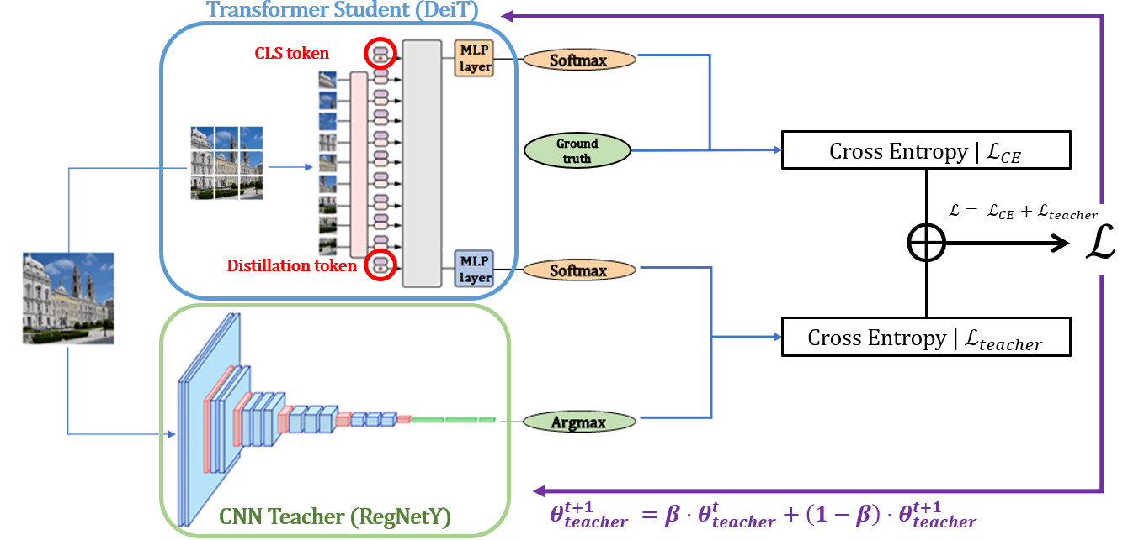

ViT vs Data-efficient Image Transformer (DeiT)
Same architecture as ViT, but optimized for small datasets.
Introduces a distillation token trained via knowledge distillation.
Learns from both ground-truth labels and a CNN teacher model.
Achieves ViT-level accuracy without large-scale data.
Reference: Training Data-efficient Image Transformers & Distillation through Attention
Facebook AI (Touvron et al., 2020)

Slide 8
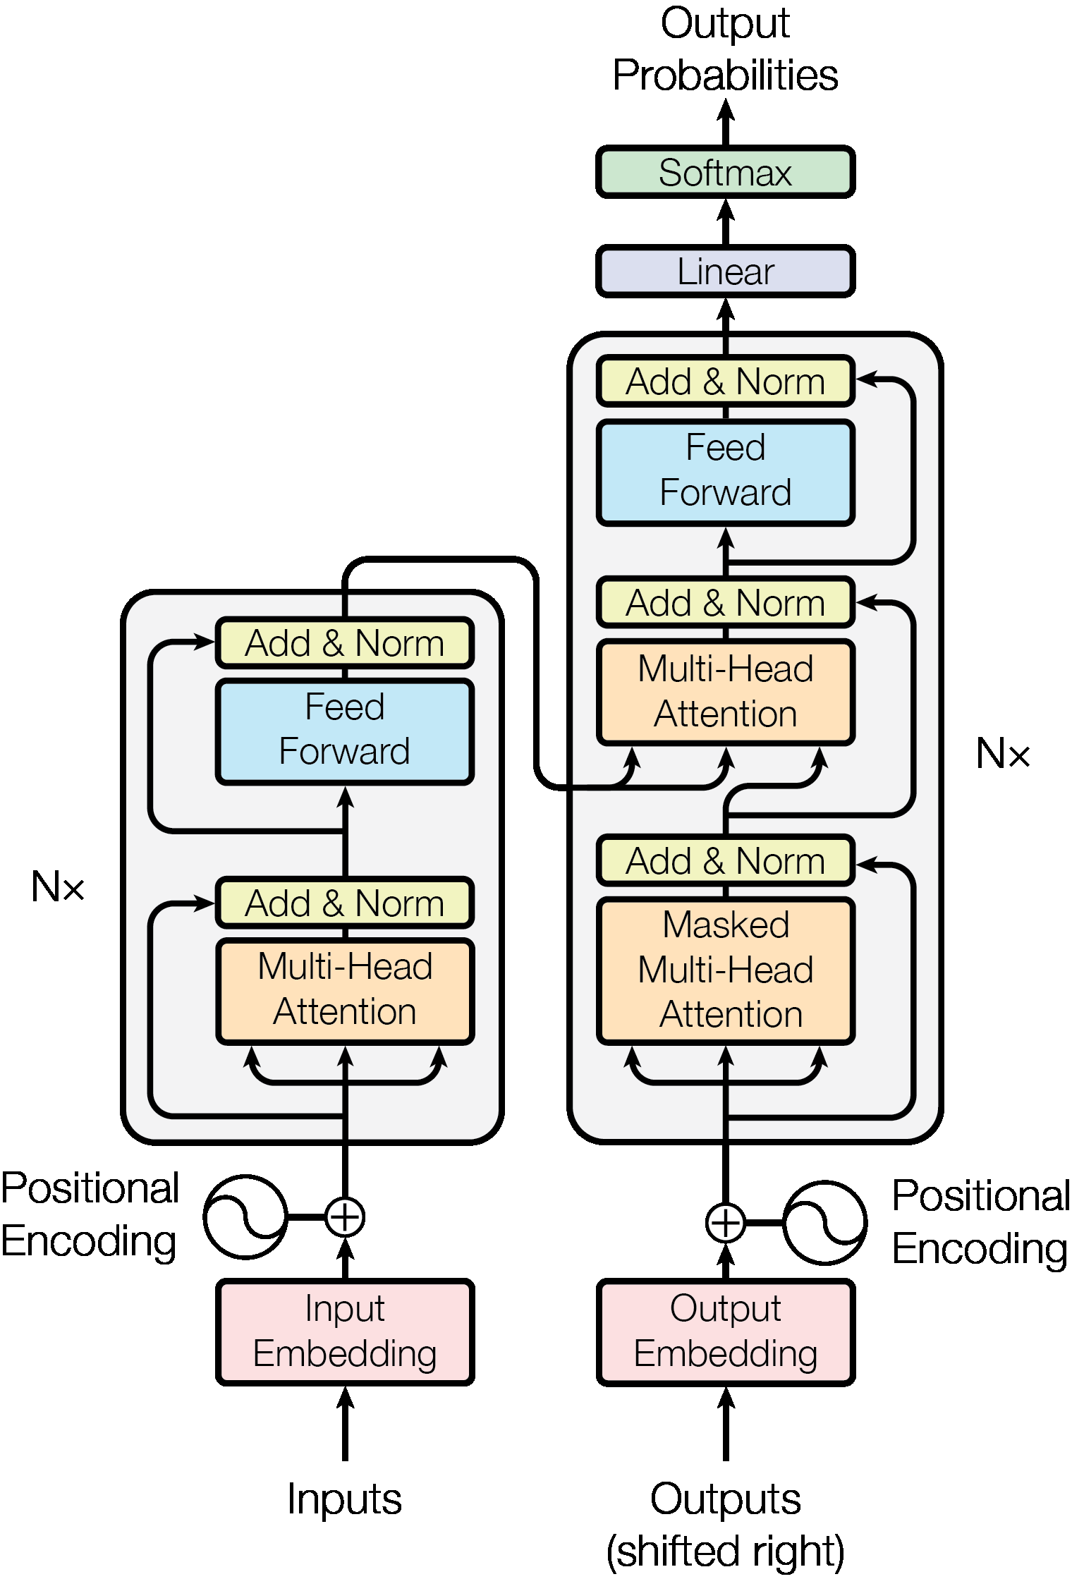

Text Transformer
Input: Words → Embeddings + Positional Encoding.
Encoder (e.g., BERT): Bidirectional self-attention.
Decoder (e.g., GPT): Masked self-attention for autoregressive generation.
Use attention to relate every word to every other word.
Powerful for classification, translation, and text generation.
Reference: Attention Is All You Need
Google Brain (Vaswani et al., 2017)

Slide 9
Phase 2 – Transformer Tweak
Idea:
Expectation:
Reality check:
Diagnostics:
Stacking similar transformers amplifies capacity, not diversity – we needed architectures with orthogonal inductive biases.
89 % slice-level accuracy (Macro-F1 0.88) – 7 pp below the DeiT baseline.
ViT supplies global context; DeiT regularises with distilled knowledge → a “best-of-both” attention map.
Fuse complementary transformer scales – pair high-capacity ViT-Base (86 M params) with fast DeiT-Tiny (5 M params) and average their logits.
Lesson learned:
Nearly identical self-attention heat-maps ⇒ redundant features. • Rapid train-set convergence but widening val-gap after epoch 10 ⇒ over-fit on minority classes. • Parameter count ballooned to 91 M, inference latency ↑ 2×; still no gain.

Slide 10
Key Insight
Capacity ≠ Capability:
Simply adding more layers or another transformer didn’t translate into higher recall; it amplified the same blind spots.
We needed orthogonal vision:
Global-only attention missed micro-textures that often delineate tumour borders.
Diversity > Depth:
Combining different inductive biases is more valuable than stacking similar ones.
Strategic Pivot: Abandon transformer-on-transformer stacking and pair two complementary CNN backbones—one tuned for multi-scale context, the other for ultra-fine detail.
Hypothesis going forward:
Heterogeneous feature fusion will close minority-class gaps without exploding parameter count or latency.

Slide 11
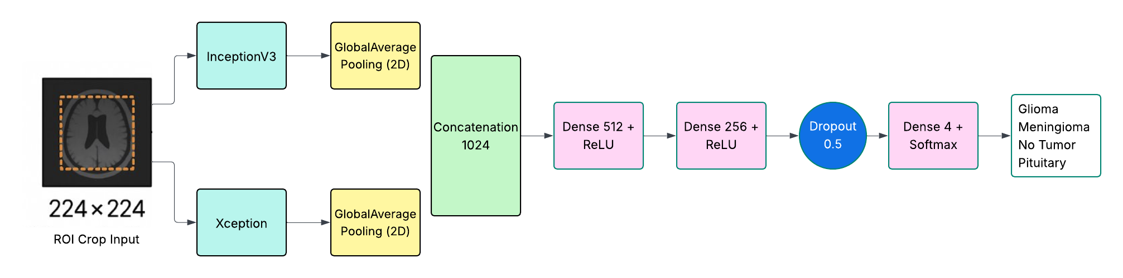
Phase 3 : CNN Ensemble
Phase 3 – CNN Ensemble
Dual-backbone design
Inception V3 → multi-scale borders
Xception → fine-texture details
Fusion pipeline
512-D GAP vectors → concat 1 024-D
Dense-512 ▸ ReLU ▸ Dense-256▸ ReLU ▸ Drop-0.5 ▸ Soft-max-4
Lean & fast
56 M params (-35 % vs DeiT)
18 ms per slice on 1× Tesla P100
Reliable & interpretable
Only 4 / 1 311 errors (glioma ↔ meningioma)
Grad-CAM focuses on lesion core + rim
Clinical-ready
Runs on standard hospital GPU
Transparent outputs for audit trails

Slide 12
InceptionV3 vs Xception
InceptionV3
Uses parallel convolution paths with different filter sizes (e.g., 1×1, 3×3, 5×5)
Captures multi-scale features in a single block
Output of all paths is concatenated
Xception
Uses depthwise separable convolutions
Splits convolution into:
Depthwise: learns spatial patterns per channel
Pointwise: learns cross-channel relationships (1×1 conv)
Simpler and more uniform architecture

Slide 13
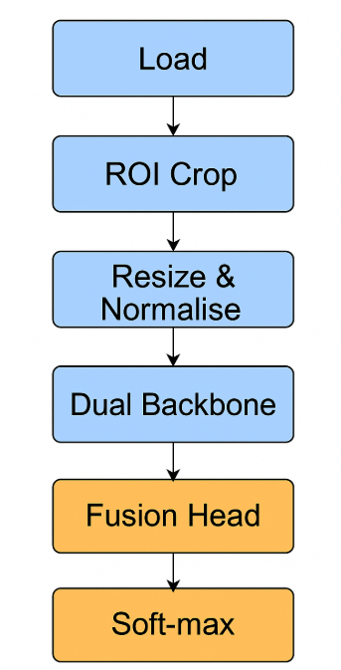
Dataset & Pre-processing
Datasets
Nickparvar – 7 023 CE-T1 MRI slices
Train 5 712 · Test 1 311
Class balance
4 labels: glioma, meningioma, pituitary, no-tumor
Near-even distribution → no SMOTE needed
Pre-processing pipeline
ROI Extraction – Otsu threshold + extreme-point crop
Resize 224 × 224 · replicate to 3 channels
Intensity scaling to [-1, 1]
Data augmentation (train only)
±15° rotation
Horizontal flip
Tensor caching – HDF5 cache boosts I/O 4×
Batching
Mini-batch 32 · PyTorch DataLoader workers = 4
Result
Identical, clean input for CNN and Transformer trials — ensures architecture, not data tricks, drive performance differences.

Slide 14
Training Configuration & Runtime
Hardware footprint
1 × NVIDIA Tesla P100 (16 GB) GPU
Mixed-precision (FP16) enabled → 25 % faster & 30 % lower memory
Hyper-parameters
Optimiser AdamW lr 1 × 10⁻⁴ weight-decay 1 × 10⁻²
Scheduler ReduceLROnPlateau (factor 0.1, patience 5)
Early-Stopping after 5 stagnant val epochs
Batching & epochs
Mini-batch 32 · DataLoader workers = 4
Epoch cap 30 — CNN ensemble converged in 15 epochs
Wall-times
CNN ensemble : ≈ 40 min full training
ViT + DeiT test run : ≈ 2 h (longer, no accuracy gain)
Throughput
18 ms per slice inference (batch 32)
≈ 0.6 s to triage a 32-slice scan → real-time PACS integration
Monitoring
Live plots for loss, accuracy, and Expected Calibration Error
Checkpoints saved on best Macro-F1 — reproducible results.

Slide 15

Metric | DeiT (baseline) | CNN ensemble | Transformer ensemble
Nickparvar test
Accuracy | 0.96 | 0.997 | 0.89
Macro Precision | 0.96 | 1.00 | 0.88
Macro Recall | 0.96 | 1.00 | 0.88
Macro F₁ | 0.96 | 1.00 | 0.88
99.7 % – New State of the Art

Slide 16
External Test (Bhuvaji)
True “Cold Start” Test
3264 CE-T1 MRI slices from a different hospital, scanner, and patient cohort
Zero fine-tuning, zero hyper-parameter tweaks
Performance at a Glance
97 % accuracy • Macro-F1 0.97
Class-wise recall ≥ 0.95 for all four tumour types
Why It Matters
Domain shift resilience – handles new voxel spacing, intensity profiles, and noise patterns
Generalisation proof – 1 pp higher than prior CNN SOTA on the same set
Clinical confidence – identical Grad-CAM focus on lesions despite scanner change
Bottom line: Model isn’t just memorising Nickparvar — it travels well to real-world data.
Metric | Baseline (DeiT) | CNN Ensemble | Transformer Ensemble
Bhuvaji test
Accuracy | 0.84 | 0.97 | 0.86
Precision | 0.84 | 0.97 | 0.85
Recall | 0.84 | 0.98 | 0.87
F1 | 0.84 | 0.97 | 0.85

Slide 17
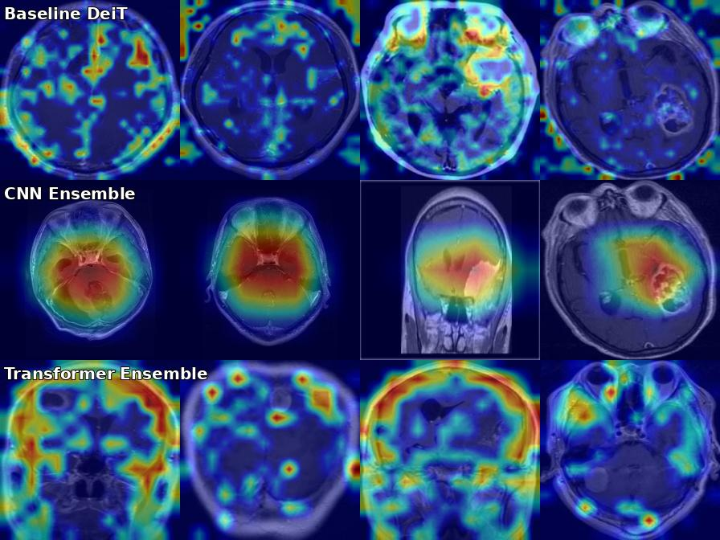
Explainability
Grad‑CAM aligns with tumour margins

Slide 18
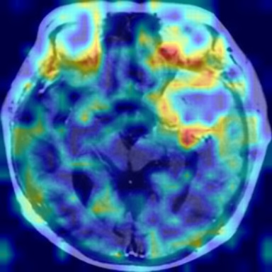
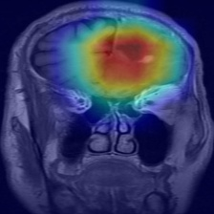
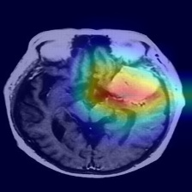
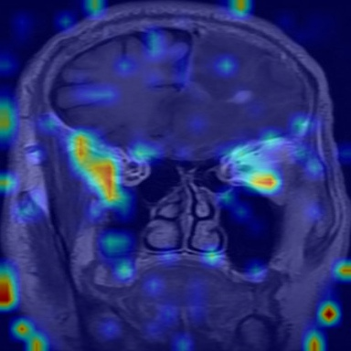
Grad-CAM:
Highlights important image regions influencing predictions
Helps debug models by showing focus areas
Builds trust with visual explanations
️ Useful for comparing models
Aids in analyzing wrong predictions

Slide 19
Scale & Stress-Test
Curate multi-centre cohort ✚ T2 & FLAIR sequences
Quantify robustness to scanner field-strength and protocol drift
Evolve the Architecture
Design CNN ＋ Transformer hybrid ≤ 30 M params
Preserve CNN speed, add global self-attention context
Human-in-the-Loop Pilot
20-radiologist prospective study
Measure: diagnostic recall, report time, Grad-CAM trust score
Regulatory Readiness
Generate IEC 62304 software file tree
Automate inference logs for audit trail compliance
Vision for Deployment
Seamless PACS plug-in → sub-second triage
Roadmap to a fully-featured computer-aided diagnostic (CAD) system for neuro-oncology
Next Steps

Slide 20
References (abridged)
[1] Mahanty S S et al., 'Pre‑trained DeiT for Brain‑Tumour Classification', ICCCNT 2024.
[2] Szegedy C et al., 'Rethinking the Inception Architecture', CVPR 2016.
[3] Chollet F., 'Xception: Depthwise Separable Convolutions', CVPR 2017.
[4] Nickparvar M., 'Brain Tumour MRI Dataset', Kaggle 2021.
[5] Bhuvaji S., 'Brain Tumour Classification MRI', Kaggle 2020.

Slide 21
Questions?
Let’s Light Up the Scan!

